Slide 1

New epa standards for per- and polyfluoroalkyl substances (pfas)
May 15, 2024 – Public informational MEETING

Slide 2
Agenda
Background
EPA Rules & Standards
Next Steps
Possible Solutions

Slide 3




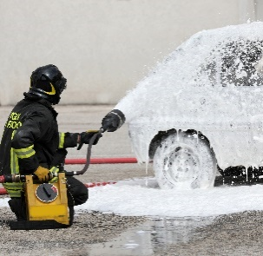
Background – what are pfas?
Per- and polyfluoroalkyl substances (PFAS)
A group of chemicals made by humans that have been used in many consumer products and industrial processes since the 1940s.
Nonstick Cookware
Cleaning Products
Water-resistant & Stain-resistant Fabrics
Personal Care Products (dental floss, shampoo, eye makeup, etc.)
Firefighting Foams

Slide 4

Background – how are we exposed?
Using consumer products treated with or containing PFAS
Eating fish from contaminated waters
Swimming or recreating in contaminated lakes or rivers
Eating food grown or raised near places with PFAS exposure
Eating food packaged in material that contains PFAS
Drinking water
Health Risks: Possible impacts to immune systems and liver functions, and an increased risk of certain cancers
Notes:
PER MDH: People can be exposed to PFAS in many ways including drinking water where the source has been impacted by PFAS contamination. For most Minnesotans, the majority of PFAS exposure comes from non-drinking water sources.

Slide 5
Background Minnesota department of health guidance
PFAS understanding has changed over the last ~20 years
The Minnesota Department of Health (MDH) has guidance values that water providers are encouraged to meet
SSP is still meeting guidance today and has not received a Health Advisory Risk letter from MDH
Guidance values are not enforceable levels
MDH Guidance Values (ppt*) - 2002 to 2023
Year | PFOA | PFOS | PFHxS | PFHxA | PFBA | PFBS
2002 | 7000 | 1000 | 0 | 0 | 0 | 0
2006 | 1000 | 600 | 0 | 0 | 1000 | 0
2007 | 500 | 300 | 0 | 0 | 7000 | 0
2009 | 300 | 300 | 0 | 0 | 7000 | 7000
2013 | 300 | 300 | 300 | 0 | 7000 | 7000
2016 | 70 | 70 | 70 | 0 | 7000 | 7000
2017 | 35 | 27 | 27 | 0 | 7000 | 2000
2019 | 35 | 15 | 47 | 0 | 7000 | 2000
2022 | 35 | 15 | 47 | 200 | 7000 | 100
2024** | 0.0079 | 2.3 | 47 | 200 | 7000 | 100
*Measured in Parts Per Trillion
** 2024 values are draft values
Notes:
Our understanding and ability to detect PFAS in the environment has evolved since the Minnesota Pollution Control Agency (MPCA) and the Minnesota Department of Health (MDH) began investigating them in 2002. Laboratories at that time only identified two PFAS and could not detect low concentrations. We are now able to measure extremely small amounts (parts per trillion in water) of several PFAS and newer studies suggest that long-term exposure to PFAS in this range might affect the most vulnerable members of the population. MDH continues to monitor the scientific research about PFAS and we will adjust our health advice as needed. (from MDH website)
Analogy – Parts per Trillion is similar to one droplet in an Olympic size pool.
The most consistently observed and strongest evidence for harmful impacts on human health is for immune suppression such as decreased vaccination response, changes in liver function such as higher cholesterol, elevated liver enzymes, and lower birth weight. In addition, lifetime exposure to PFOA has also been associated with kidney cancer. MDH develops guidance values to protect people who are most highly exposed and people who are most sensitive to the potentially harmful effects of a contaminant, including pregnant people, fetuses, infants, and children. (per MDH)

Slide 6
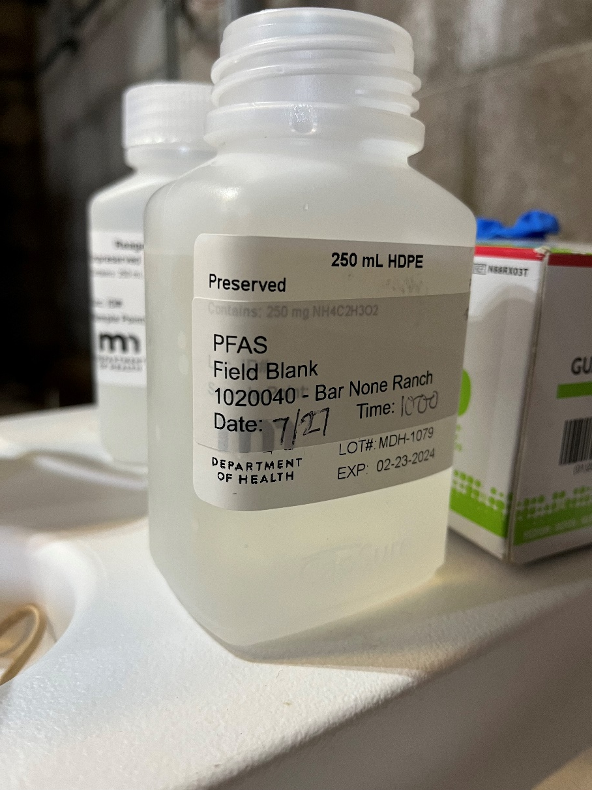
MDH PFAS Sampling efforts
Proactive testing – before required by EPA
Statewide testing – 95% of community systems
Advanced Testing – now detecting below 2 ppt
Current detection limits much lower than in past
South St. Paul – started PFAS sampling in 2007
First detections of PFOA in 2022
Sampling Wells 4 and 9 quarterly
South St. Paul is still meeting MDH guidance as of today

Slide 7

epa rule and standards
Compound | Maximum Contaminant Level (MCL) in parts per trillion (ppt)
PFOA | 4.0 ppt
PFOS | 4.0 ppt
PFHxS | 10 ppt
PFNA | 10 ppt
HFPO-DA (commonly known as GenX Chemicals) | 10 ppt
Mixtures containing two or more of PFHxS, PFNA, HFPO-DA, and PFBS | 1 (unitless)*
April 10th, 2024
EPA issued the first-ever rule for PFAS in drinking water
= 5 PFAS Chemicals
(+hazard index for mixtures of 2+)
*An equation that weights the different chemicals is used to calculate the “Hazard Index”
Notes:
FROM EPA ON HAZARD INDEX - Decades of research show mixtures of different chemicals can have additive health effects, even if the individual chemicals are each present at lower levels. This means that low levels of multiple PFAS that individually would not likely result in adverse health effects may pose health concerns when combined in a mixture. The Hazard Index is a long-established approach that EPA regularly uses, for example in the Superfund program, to determine the health concerns associated with exposure to chemical mixtures. EPA’s Hazard Index Maximum Contaminant Level (MCL) is set at 1 and applies to any mixture containing two or more of PFNA, PFHxS, PFBS, and HFPO-DA (known as “GenX chemicals). These PFAS can often be found together in different mixtures and research shows that exposure to mixtures of these chemicals may have additive health impacts.

Slide 8



epa rule and standards
2027
Communities that exceed the PFAS levels must take action to meet the new levels and must notify the public of the violation
2029
Communities with PFAS in drinking water have until 2027 to complete initial testing and monitoring
Levels based on quarterly testing results

Slide 9

PFAS in south st. Paul water
WE ARE NOT CURRENTLY IN VIOLATION OF
ANY EPA RULES
South St. Paul water users
do not need to seek alternative sources of water and they do not need to boil water before use
Staff worked with consultants and the MDH to review past water testing data.
Only one well has enough data to determine that it would be above the EPA limits if they were enforced today.
On April 10th, MDH contacted South St. Paul about PFAS in our system.
Notes:
16 ppt was recorded at an emergency well, that is not currently supplying water to SSP water users.

Slide 10
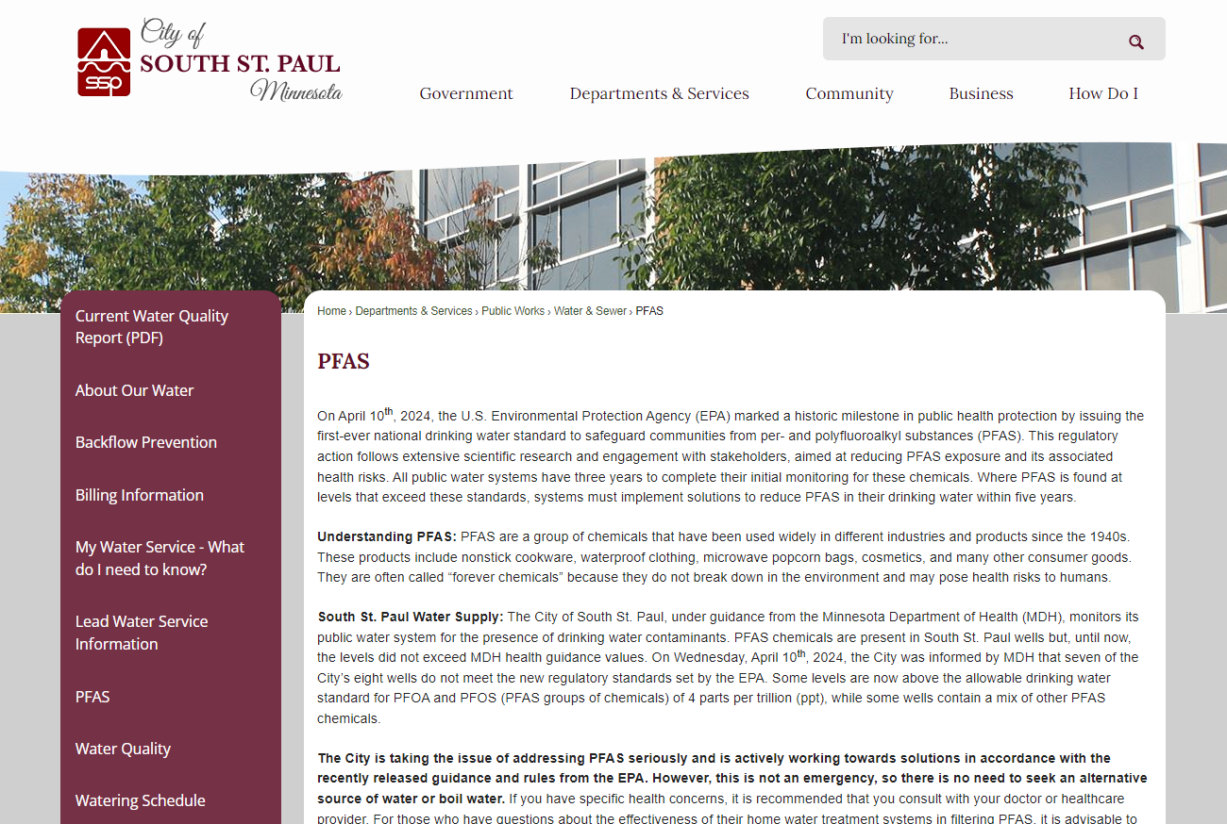
COMMUNICATING EFFORTS
On April 11th, 2024, staff posted a press release
Dedicated PFAS page on City website
Continued communication with residents to be provided as information becomes available
However, we are not currently violating any EPA rules

Slide 11
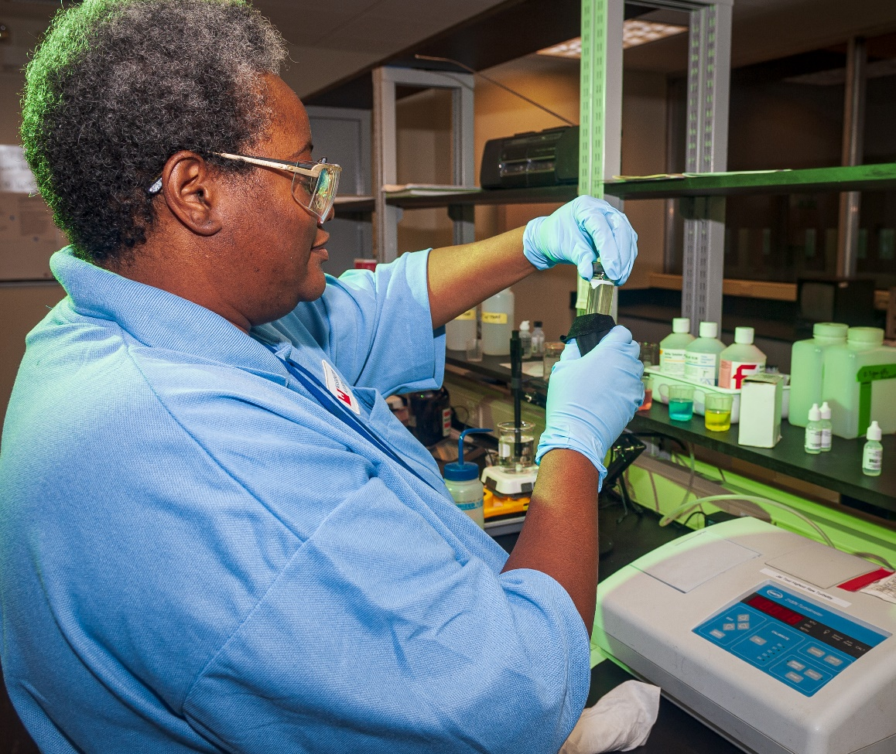
Current & next steps
Performing quarterly testing
Collaborating with the MDH and other agencies to determine the source of PFAS in our water
Applying for drinking water planning and design funds
Preparing a feasibility study to compare options
Notes:
We believe that part of our violation is that we have PFAS at low levels for some wells, but we don’t have quarterly testing data to prove that we’re under the limits

Slide 12
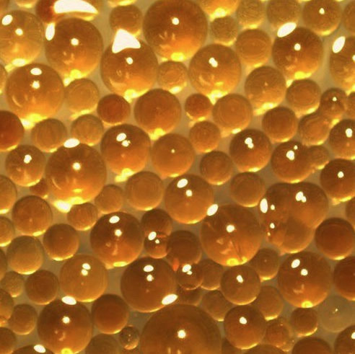
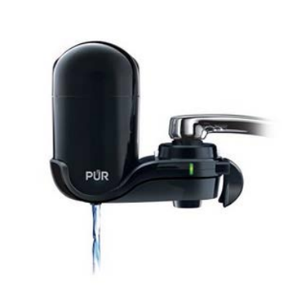
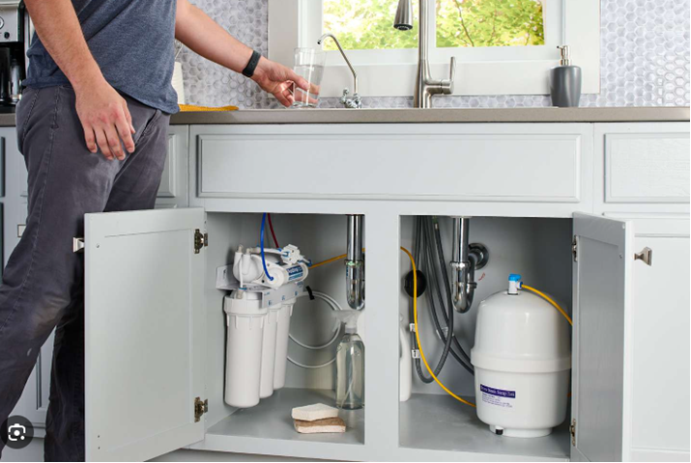
Possible solutions
In-home treatment options
Reverse Osmosis
Granular Activated Carbon (GAC)
Ion Exchange Resins
System wide options
Blending wells to dilute below limits
Purchasing treated water from other water providers
Connecting to other water providers
Implementing treatment methods at existing wells
Decommissioning wells with high levels of PFAS
Search online for “MDH PFAS Home Treatment”
Images of ion exchange resin (top left), a GAC faucet filter (top right), and an under the sink reverse osmosis system (bottom)
Notes:
Costs for system wide options would be evaluated as part of a feasibility study.
FROM MDH:
Reverse osmosis uses energy to push water through a membrane with tiny pores. The membrane stops many contaminants while allowing water to pass through. Reverse osmosis is more practical as a point-of-use treatment option (not at point-of-entry).
Granular activated carbon filter: Contaminants accumulate on the filter while water passes through.
MPCA, MDH and West Central Environmental Consulting evaluated one inexpensive, easily installed, point -of-use carbon filter option for filtering drinking water at a sink faucet: Evaluation of Perfluorochemical Removal by a Small, In-home Filter (PDF).
Learn more about Water Treatment Using Carbon Filters: GAC Filter Information.
Ion Exchange Resins: Contaminants are attracted to the tiny beads of resin and they keep the materials from passing through the water system. There are some ion exchange resin systems that may remove PFAS, but be careful to ensure any system selected meets the NSF/ANSI certification standards listed below.
In Minnesota, water treatment systems must be installed by a licensed and bonded plumbing or water conditioning contractor, although homeowners may install equipment in homes they own and occupy. After the treatment system is installed, it is important to follow the manufacturer’s recommendations for maintaining the system.

Slide 13

COST OF Possible solutions
Dependent on measured PFAS levels in all wells
Dependent on treatment options and technology used
Dependent on funding available
Continue work to define associated costs with meeting EPA regulations
Notes:
Costs for system wide options would be evaluated as part of a feasibility study.
FROM MDH:
Reverse osmosis uses energy to push water through a membrane with tiny pores. The membrane stops many contaminants while allowing water to pass through. Reverse osmosis is more practical as a point-of-use treatment option (not at point-of-entry).
Granular activated carbon filter: Contaminants accumulate on the filter while water passes through.
MPCA, MDH and West Central Environmental Consulting evaluated one inexpensive, easily installed, point -of-use carbon filter option for filtering drinking water at a sink faucet: Evaluation of Perfluorochemical Removal by a Small, In-home Filter (PDF).
Learn more about Water Treatment Using Carbon Filters: GAC Filter Information.
Ion Exchange Resins: Contaminants are attracted to the tiny beads of resin and they keep the materials from passing through the water system. There are some ion exchange resin systems that may remove PFAS, but be careful to ensure any system selected meets the NSF/ANSI certification standards listed below.
In Minnesota, water treatment systems must be installed by a licensed and bonded plumbing or water conditioning contractor, although homeowners may install equipment in homes they own and occupy. After the treatment system is installed, it is important to follow the manufacturer’s recommendations for maintaining the system.

Slide 14
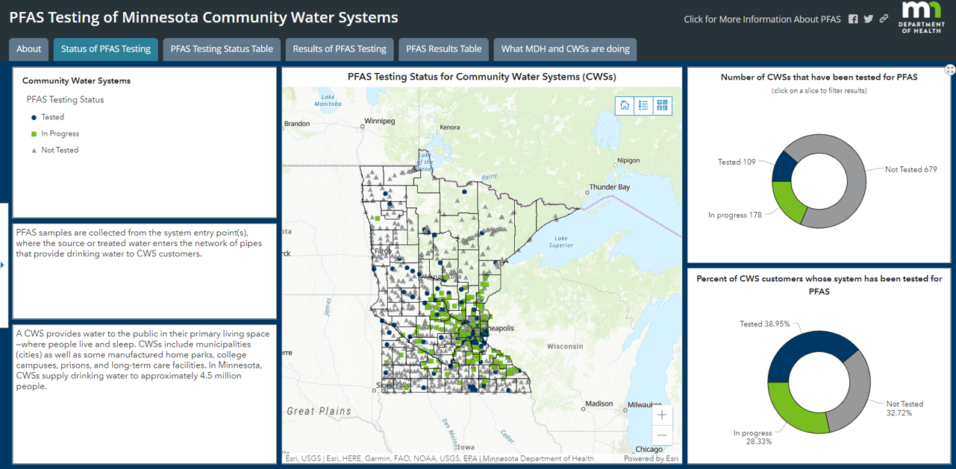
MDH Interactive Web Dashboard
Started in June 2022
Status of PFAS testing
PFAS testing results
MDH guidance
EPA MCLs
https://www.health.state.mn.us/communities/environment/water/pfasmap.html
Notes:
Made available on the MDH website June 2022
Interactive – people can click on a community to learn about its public water system, its PFAS testing status, its PFAS results, and whether their results are below, at, or above MDH guidance values
(Nearly all systems tested so far have results below guidance values)
There is information about our health guidance values and how they are calculated, as well as information about steps MDH and water systems are taking to test and minimize PFAS levels in drinking water

Slide 15
Discussion & questions

Slide 16
Sources
https://www.epa.gov/pfas/pfas-explained
https://www.health.state.mn.us/communities/environment/hazardous/topics/pfcs.html
https://www.health.state.mn.us/communities/environment/hazardous/topics/pfashealth.html
https://www.dhs.wisconsin.gov/chemical/pfas.htm

